Slide 1

P.R.E.S.S.
Pressure Reactive Electronic Solar Stones
Group # 20
Amanda Ross (EE)
Benjamin Gafoor (EE)
Mariah Kenny (EE)
Phillip Dunlop (EE)
Funded by:
Leidos
Duke Energy

Slide 2
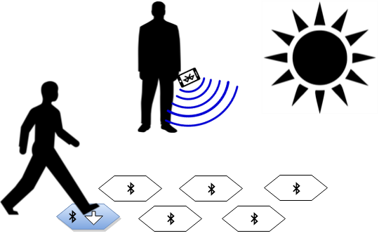
Goals & Objectives
Provide the user an easy way to brighten an outdoor pathway
To use renewable energy as a power source specifically solar energy
Design a system that is completely self sustained and easily operated by the user.

Slide 3
Specifications
Each stone structure should be able to hold up to 215 lbs and be completely weather proof.
Stones will be activated by change in pressure or phone application
All power obtained by solar energy
Wireless communication via Bluetooth
Phone application to be available on Android Devices

Slide 4
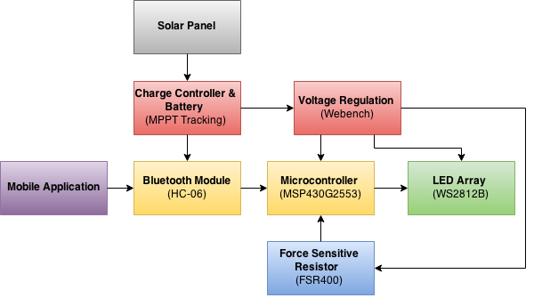
Overall System Block Diagram

Slide 5
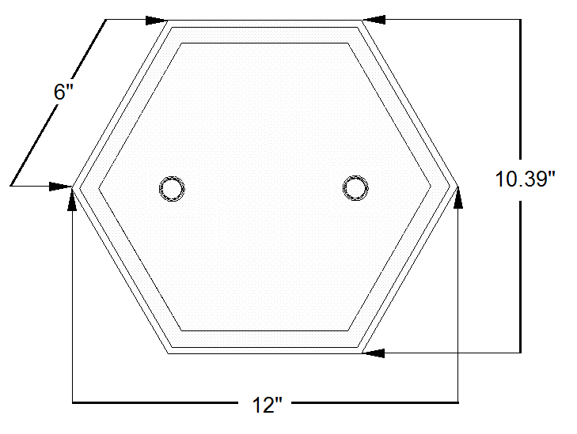
Structure – Top View
Hexagon Shaped
Plexiglas top
Pine wood sides
Thompson’s water sealant
Counter synced screws for bonding sides and bottom
Outdoor rated screws

Slide 6
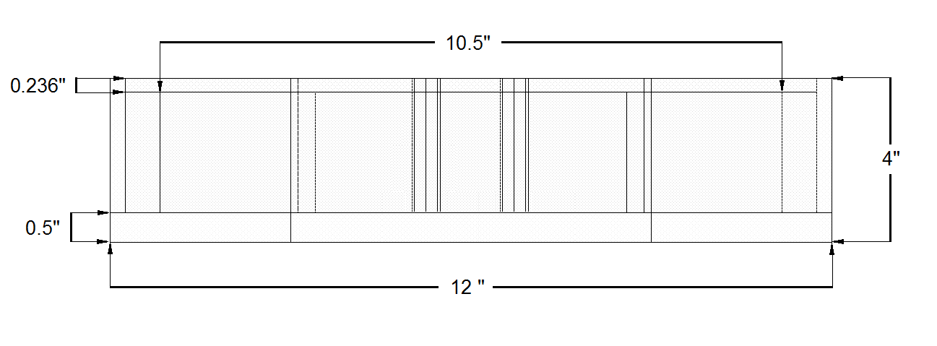
Structure - Side View

Slide 7
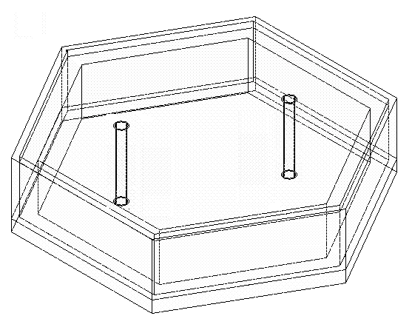
Structure - Inside Top View

Slide 8
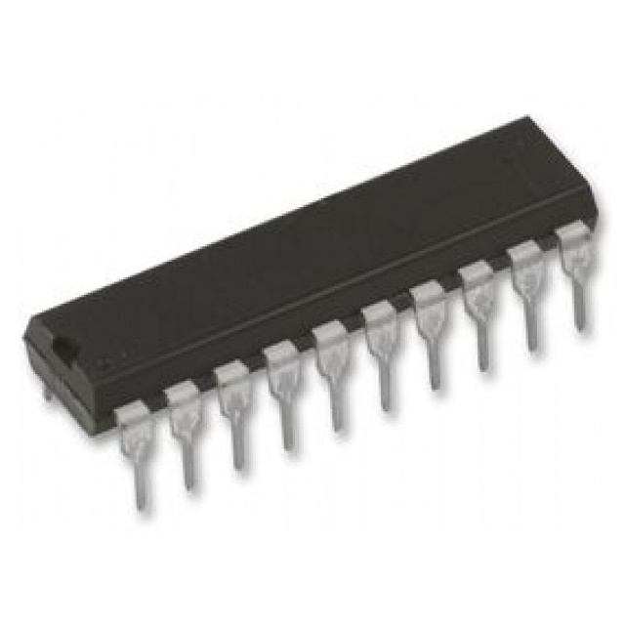
MCU
Features | Specifications
Flash (kB) | 16
Frequency (MHz) | 16 (internal)
Analog to Digital Converter | ADC10 8CH
SPI | 1
UART | 1
Min VCC (V) | 1.8
Max VCC (V) | 3.6
RAM (B) | 512
MSP 430G2553 – 16 bit Ultra Low Power Microcontroller
Low power consumption perfect for solar energy
Internal configurable clock speeds
6.35mm
25.4mm

Slide 9
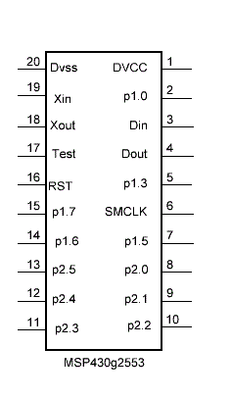
MCU
Chose this MCU so a dip socket could be used for simple programming
Low power
Familiar with programming environment
Dev-board available for free
Open source schematics for reference on Texas Instruments website
MSP430 libraries for EagleCAD open source

Slide 10
MCU Flow Chart

Slide 11
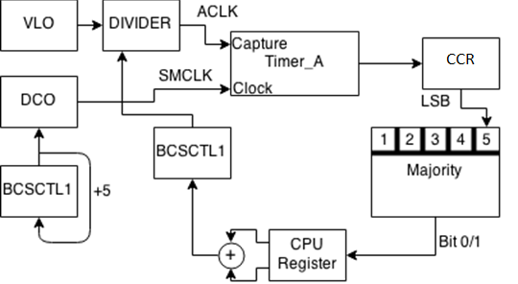
Random Color Generator
Uses two internal clock systems and timer system built into MCU.
Utilizies very-low-frequency Oscillator and digitally controlled oscillator.
Timer_A counts the number of DCO pulses in every VLO clock cycle.
Independent clock sources produce an unpredictable difference.
This difference is used to generate a random number.
The random numbers are put into an array of size 3 to set colors.

Slide 12
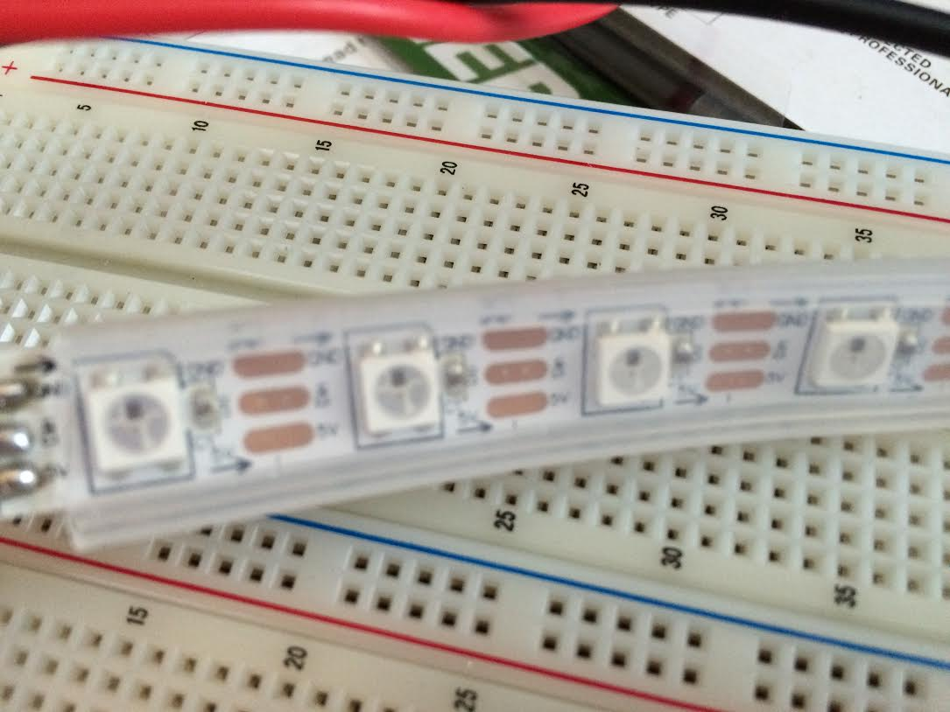
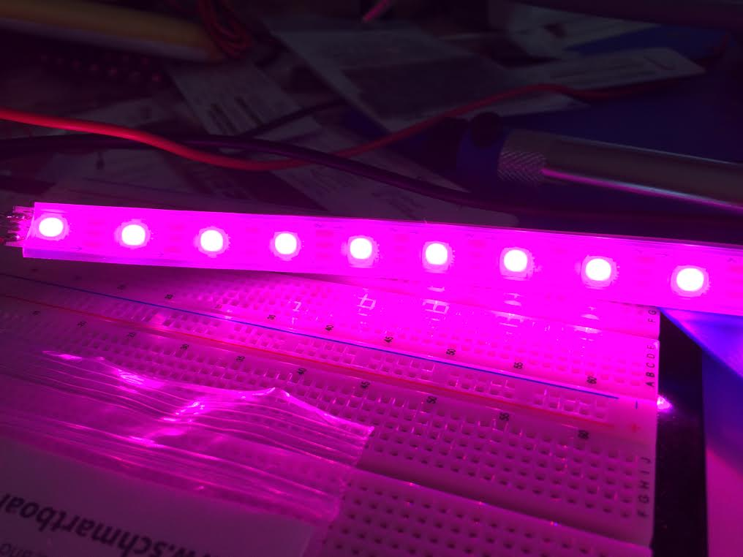
LEDs – WS2812B
LED with low driving voltage, environmental protection and energy saving, high brightness, viewing angle is large, good consistency, low power, long life and other advantages.
Has LED driver built into each individual LED
Comes mounted on flexboard PCB
Comes with weatherproof casing
RGB colors gives 16777216 possible colors

Slide 13
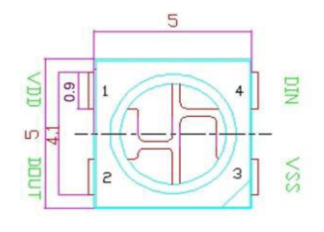
WS2812B Specifications
Parameter | Rating
Power Supply Voltage VDD | +3.5 - +5V
Input Voltage | -0.5-0.5 V
Viewing Angle | 120 degrees
RGB IC Characteristic | Intensity + Voltage
Red | 390-420 mcd 2-2.2 V
Green | 660-720 mcd 3-3.4 V
Blue | 180-200 mcd 3-3.4 V
Each LED takes 8 bits for each primary color for brightness, requiring 24 bits to program an individual LED.

Slide 14
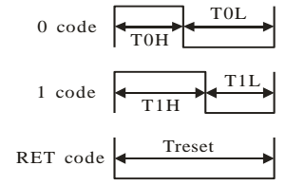
WS2812B Specifications
DATA TRANSFER | TH+TL = 1.25 µs
T0H | 0 code, high voltage time | 0.4 µs | ± 150 ns
T0L | 0 code, low voltage time | 0.85 µs | ± 150 ns
T1H | 1 code, high voltage time | 0.8 µs | ± 150 ns
T1L | 1 code, high voltage time | 0.45 µs | ± 150 ns
RES | Low voltage time | Above 50 µs

Slide 15
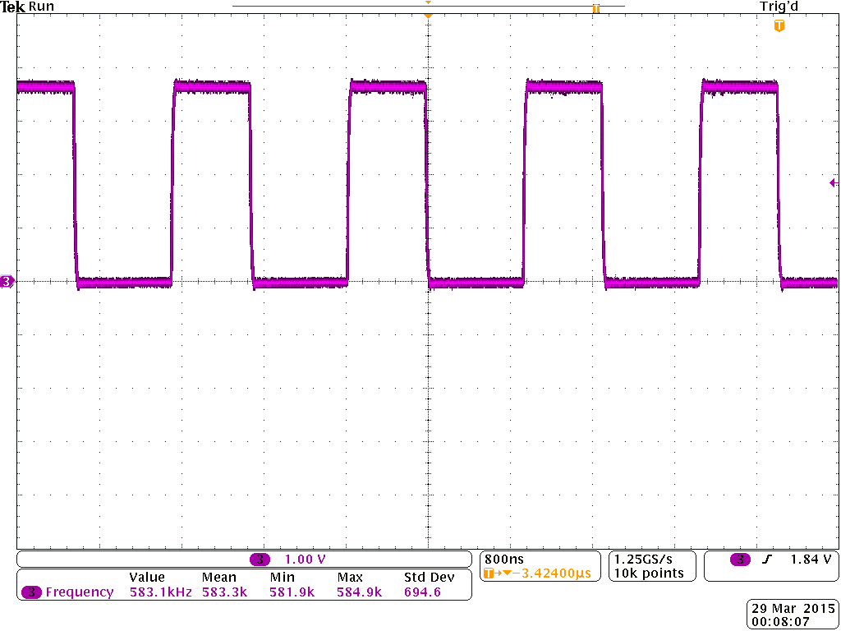
MCU Output for LEDs
DATA | VALUE
Red | 0xFF
Green | 0x00
Blue | 0x00
Frequency | 583.1 kHz

Slide 16
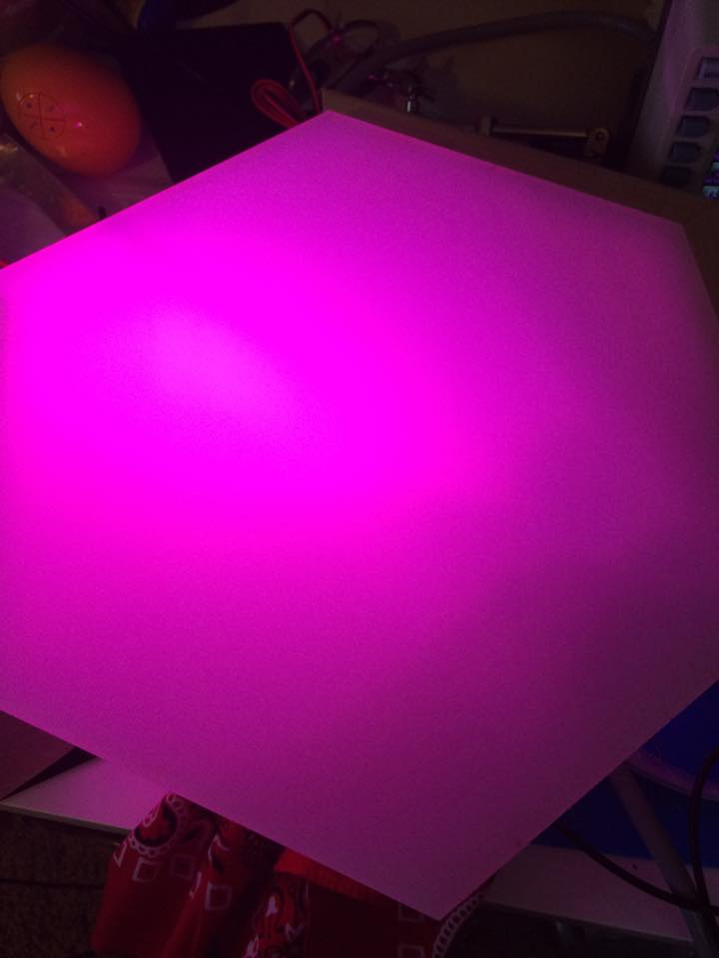
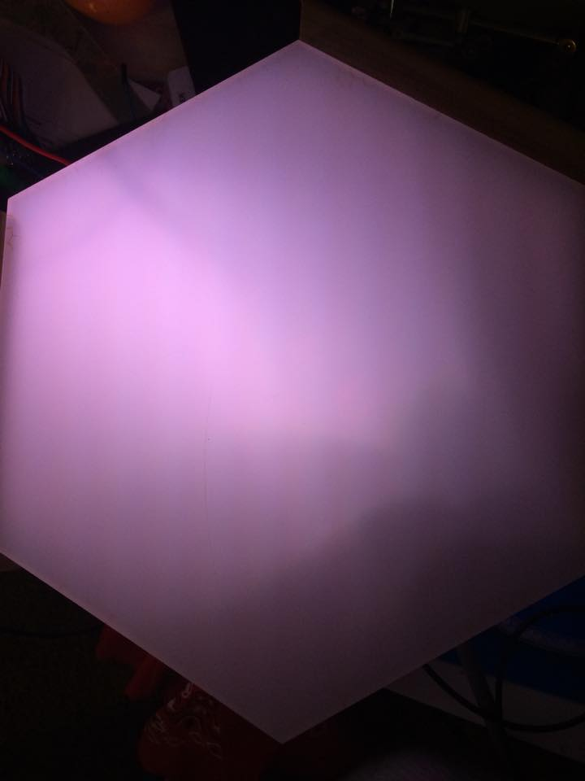
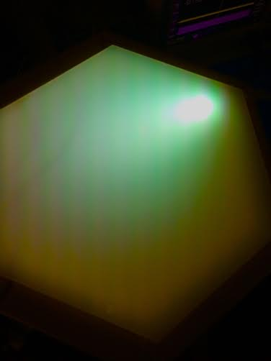
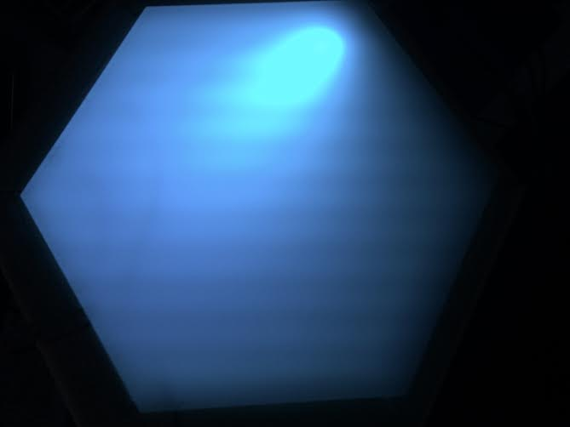
LEDs Inside Stone

Slide 17
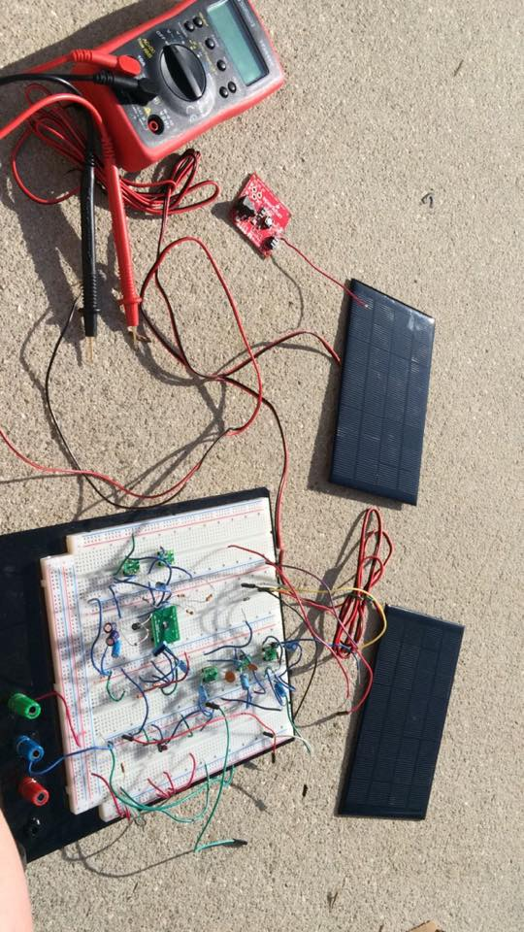
Solar Power System
Solar Panel – Monocrystalline PV Panel
Charge Controller – MPPT Solar Charger using LT3652
Battery – Lithium Ion Battery

Slide 18
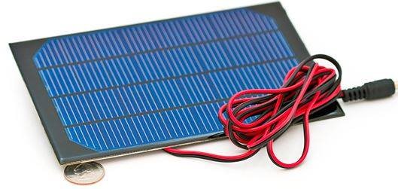
Solar Panel – Monocrystalline PV Panel
Specifications
Dimensions | 7 X 4.5 inches
Open Circuit Voltage | 8V
Short Circuit Current | 310 mA
Power Supplied | 2.5 Watts
Efficiency | 15-15.2%

Slide 19
MPPT - Maximum Power Point Tracking
MPPT finds the maximum power operating point of the solar panel.
Sweeps the panel periodically and compares it to the operating conditions where maximum power is achieved.
The operating point will continuously waver to ensure it is operating at the panels peak.
The maximum power point can also be set by measuring the power at its highest output. This will then be the set maximum operating point the future inputs will be compared too.

Slide 20
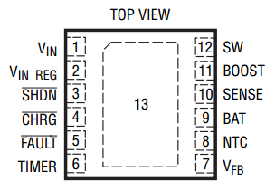
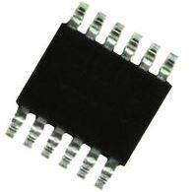
MPPT Charge Controller – LT3652
LT3652 complete monolithic step-down battery charger using MPPT.
Adjustable input voltage range from 5V – 32V and charge rate up to 2A.
Constant current/voltage output design that is programmed from regulation voltage dividers in the input and output.
The panel voltage is measured, if input voltage falls below programmed level from regulation loops, the load from the panel is reduced.
4mm
3mm

Slide 21
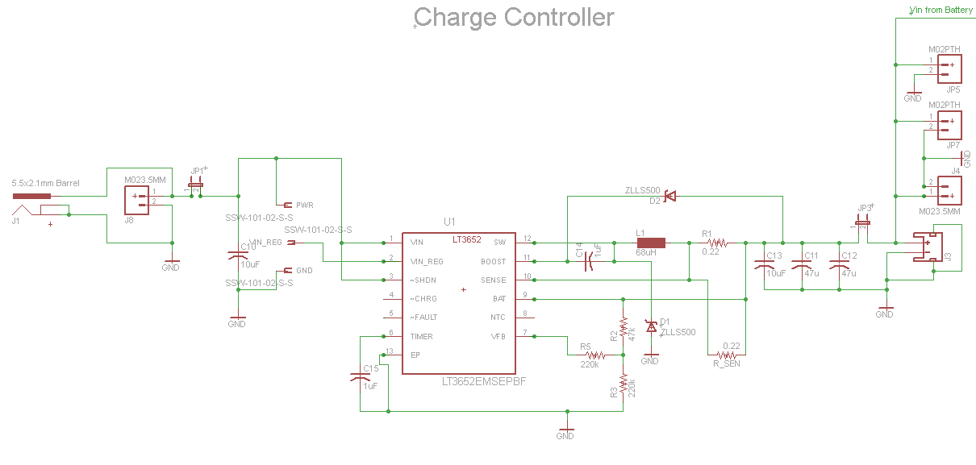
Charge Controller Schematic

Slide 22
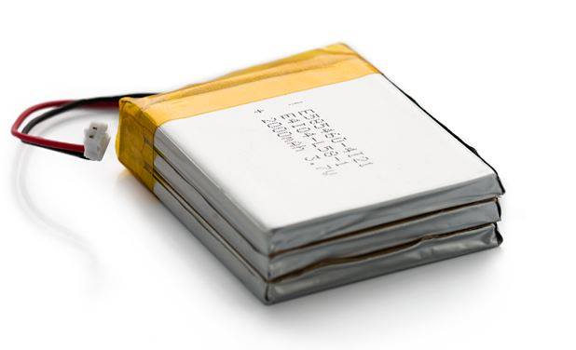
Battery – Polymer Lithium Ion Battery
Three 2000 mAH lithium ion batteries stacked in parallel to increase amount of storage.
Great for extreme weather conditions ranging from -25 to 60 C.
Charged in 4 hours of direct sunlight from solar panel.
Provides power directly to HC-06 Bluetooth Module
Specifications
Nominal Capacity | 6 Ah
Nominal Voltage | 3.7 V
Charge voltage | 4.2 V
Discharge Current | 1 A continuous
19mm
60mm
54mm

Slide 23
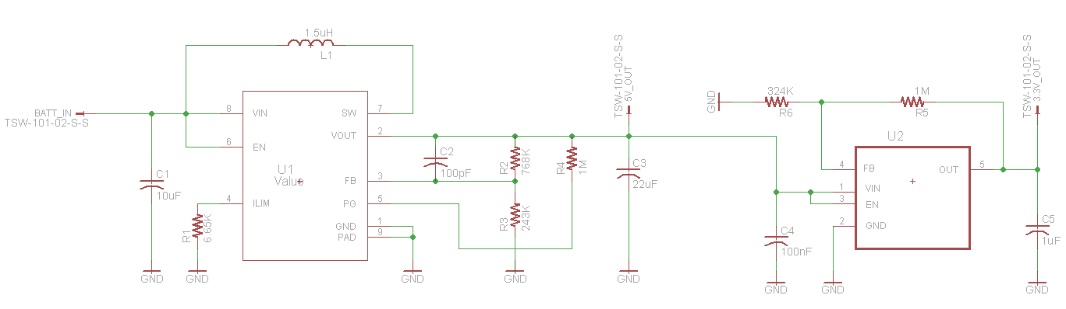
DC – DC Converters
Step 1: TPS61252 Step-Up Boost converter
  The battery inputs 3.9 V and the converter outputs 5 V to 10 WS2812B LEDs lined in series.
Step 2: TPS71701 Low-dropout Linear Regulator
  Takes in 5 V from the TPS61252 and outputs 3.3 V to the MSP430, and the Force Sensitive Resistor.

Slide 24


Bluetooth Vs. Wi-Fi
Decision needed to be made between Wi-Fi and Bluetooth for the wireless communication to the stones.
Wi-Fi has much faster transmission speeds and longer range. However uses much more power and is more complex to implement.
Bluetooth is energy efficient and simpler to utilize. Slower transmission speeds and shorter range will not be an impact on our project.

Slide 25
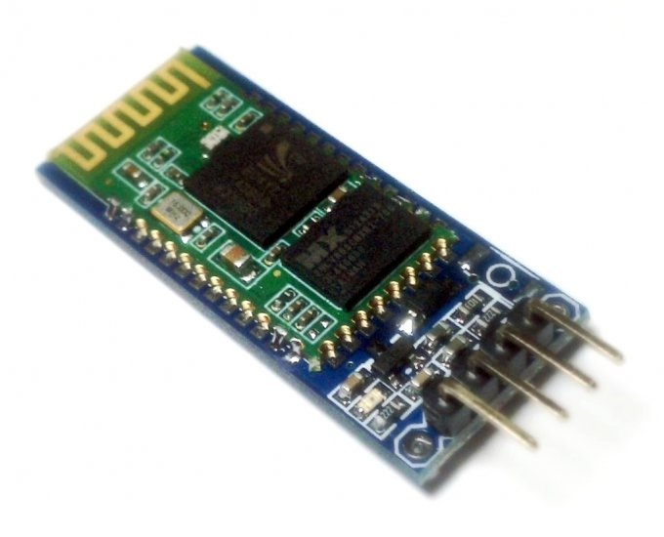
Bluetooth Module
Specifications
Bluetooth Standard | Version 2.0
Frequency (GHz) | 2.4 ISM Band
Connecting Current (mA) | 35
Connected Current (mA) | 8
Temperature (Celsius) | -40 – 105 degrees
Supply Voltage (V) | 2.7 – 4.2 V
The Bluetooth module that was chosen was the HC-06.
Low power consumption.
1.1 ‘’
0.5 ‘’

Slide 26
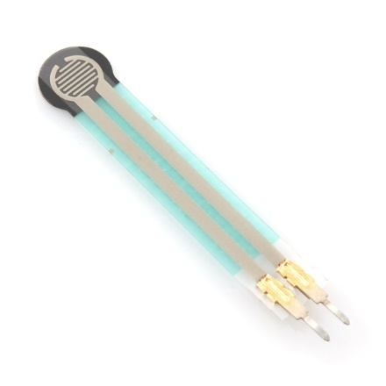

Force Sensitive Resistor
SPECIFICATION | VALUE
Force Sensitivity Range | 0.1 – 10,000 N
Force Resolution | Continuous
Non-Actuated Resistance | >10 MΩ
Device Rise Time | <3 µs
Number of Actuations | 10 million
Sensor Size | 4 mm
1.75’’
0.28’’
Resistance drops as force increases.
Using 10 bit ADC on MCU to sense if enough force to light stone.
Resistor divider is based off of the 3.3 V input from the TPS71701 voltage regulator to produce 0.2 V across the RM resistor.
Small, compact, and consistent.

Slide 27
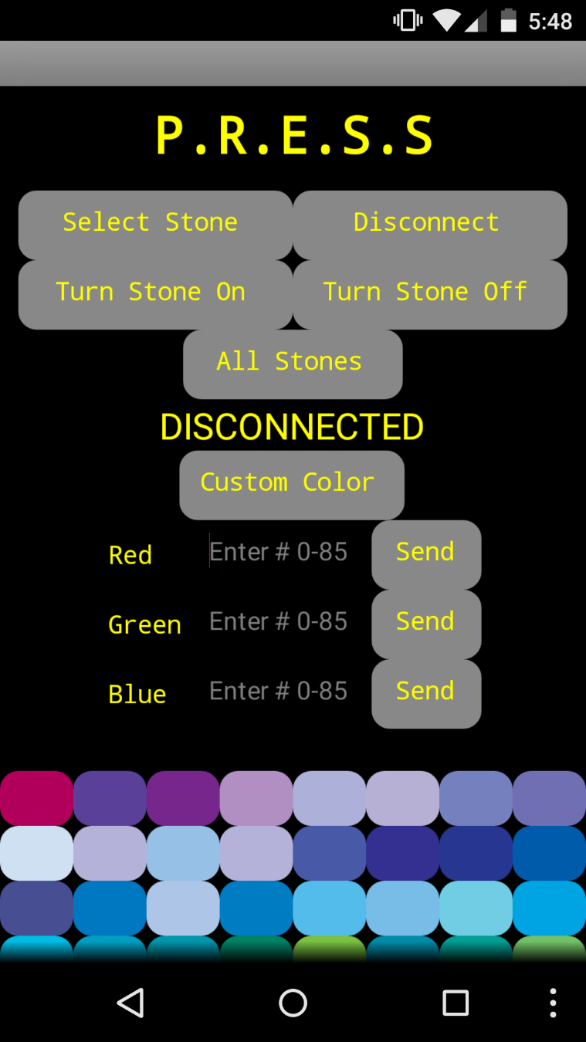

Application
Mobile application was developed for Android devices.
Primary features include:
  Wirelessly connect to stones using Bluetooth 2.0 technology.
  Once connected be able to manually turn on the stones.
  Change color of stones via custom color tool and premade color swatches.
  Various lighting features including random, chase, strobe, etc.

Slide 28
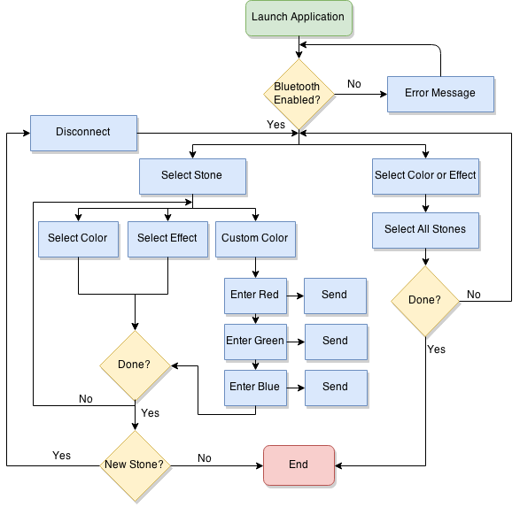
Application Flow Chart
Application can either connect to one stone individually or communicate a command to all the stones.
When connected to an individual stone the user can select a color from the color library, create their own using the custom color creation tool, and apply any effect they wish. This custom color will also become the color that is shown when stepped on.

Slide 29
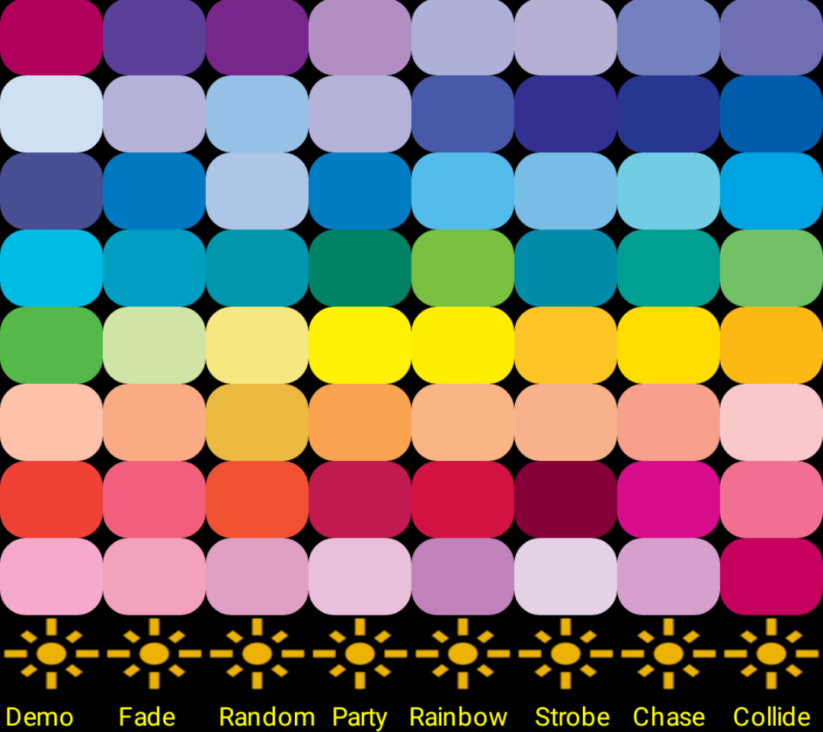
Application Communication
64 preprogrammed colors displayed in an eight by eight grid.
Each color has its own unique ASCII code associated with it.
This ASCII is sent over the Bluetooth serial connection to the MCU. A switch statement determines which code to execute based on the ASCII character.

Slide 30
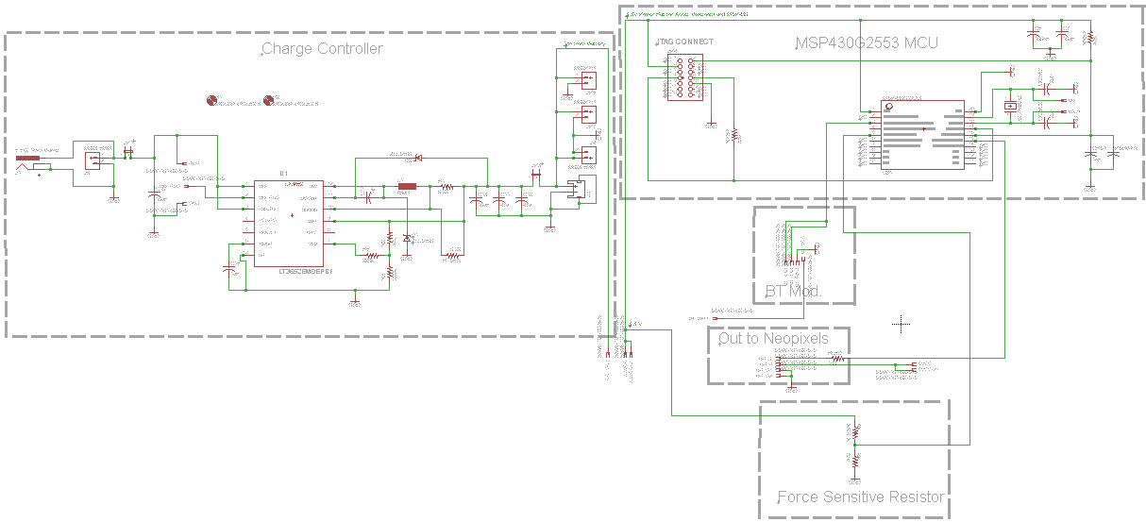
Main Board Schematic

Slide 31
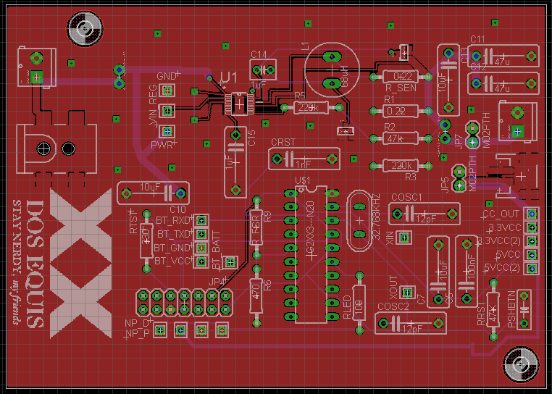
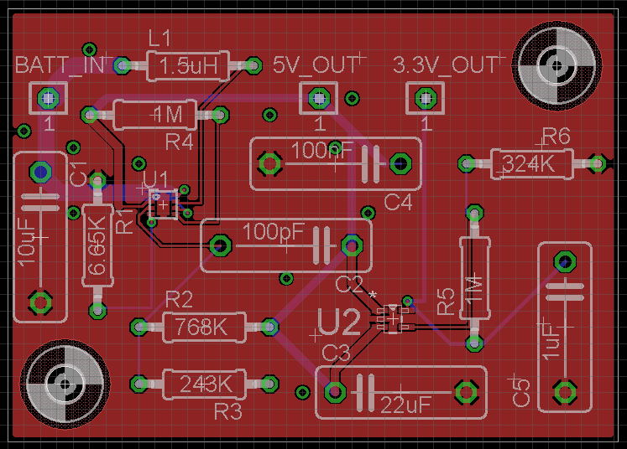
PCB Integration
Main PCB board:
  Charge Controller to send voltage from panel to battery.
  MCU and JTAG interface.
  Bluetooth and FSR inputs & outputs to LEDs.
Voltage Regulation Board:
  Step up boost converter for 4V input to 5V output for LEDs and Bluetooth.
  Low dropout linear regulator for 3.3V output for other circuit components.

Slide 32
Budget
Purchased
Item Category | Cost
Solar power and charge controller materials | $ 556.44
Structure materials: wood, screws, plexiglas etc. | $ 329.81
LED strip lights, connectors and mounting brackets | $ 118.25
Breakout boards for prototyping with ICs | $ 213.74
Voltage regulation components | $ 52.82
Pressure sensing: Accelerometers and FSRs | $ 112.90
Bluetooth Modules | $ 49.95
Electrical components: resistors, capacitors, etc. | $ 161.78
PCBs from Osh Park | $ 353.80
Miscellaneous Items | $ 276.68
Total Spent: | $ 2,226.17
Grand Totals
Leidos & Duke Total Granted Funding: | $2,190.00
Total expenses covered by group members: | $36.17
Total Spent: | $2,226.17

Slide 33
Schedule
Task Name | Start | Finish | Resource Names
Research | Mon 9/1/14 | Wed 11/19/14 | Phill,Amanda,Mariah,Ben
Prototype | Thu 12/4/14 | Sat 2/28/15
Order Parts | Mon 1/5/15 | Mon 1/5/15 | Phill,Mariah,Amanda,Ben
Structure Prototype | Fri 1/16/15 | Fri 1/16/15 | Ben,Mariah,Amanda,Phill
Lighting Prototype | Fri 1/16/15 | Sat 2/28/15 | Ben
Application Prototype | Fri 1/16/15 | Fri 2/6/15 | Phill
Bluetooth LE Prototype | Fri 1/16/15 | Sat 2/28/15 | Phill,Amanda
Power Prototype | Fri 1/16/15 | Sat 2/28/15 | Mariah
Initial PCB Design | Fri 1/23/15 | Fri 2/27/15 | Amanda
Testing | Sun 2/1/15 | Mon 3/9/15
Mount Parts to Breakout Boards | Sat 2/7/15 | Sat 3/7/15 | Phill,Mariah,Amanda,Ben
Order PCB | Sat 3/7/15 | Sat 3/7/15 | Amanda
Lighting Test | Sun 3/1/15 | Sat 3/28/15 | Ben
Power Test | Sun 3/1/15 | Sat 3/28/15 | Mariah
Application Test | Sun 3/1/15 | Sat 3/28/15 | Phill
Wireless Communication Test | Sun 3/1/15 | Sat 3/28/15 | Amanda
Multi-stone Test | Sat 3/28/15 | Tue 3/31/15 | Mariah,Phill,Amanda,Ben
Mount Parts to PCB | Sun 3/29/15 | Sun 3/29/15 | Mariah,Phill,Amanda,Ben
Build | Mon 4/6/15 | Fri 4/8/15 | Mariah,Phill,Amanda,Ben
Test System | Mon 4/8/15 | Wed 4/15/15 | Mariah,Phill,Amanda,Ben

Slide 34
Questions?

